Slide 1
Analyzing Ferrari’s last years in F1 - Neo4j portion -
Luca Sannino 1542194

Slide 2
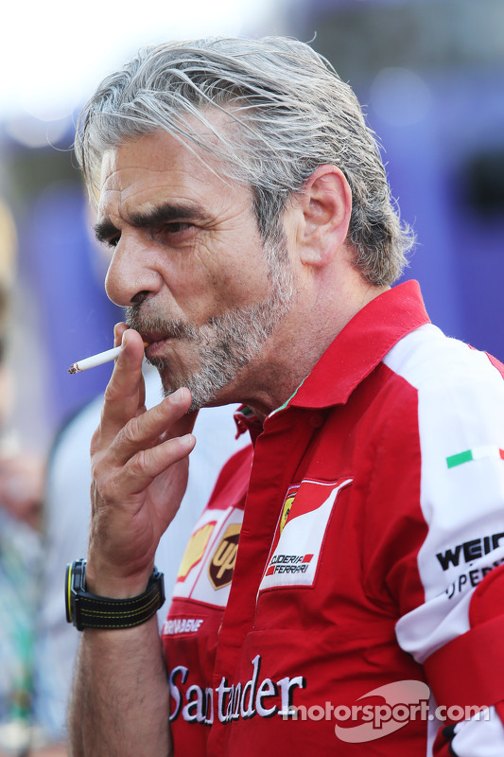


• Hi, my name is Luca…
and I’ve recently become the new team principal at Ferrari!
2014-2019
2019-2020
2020-????

Slide 3
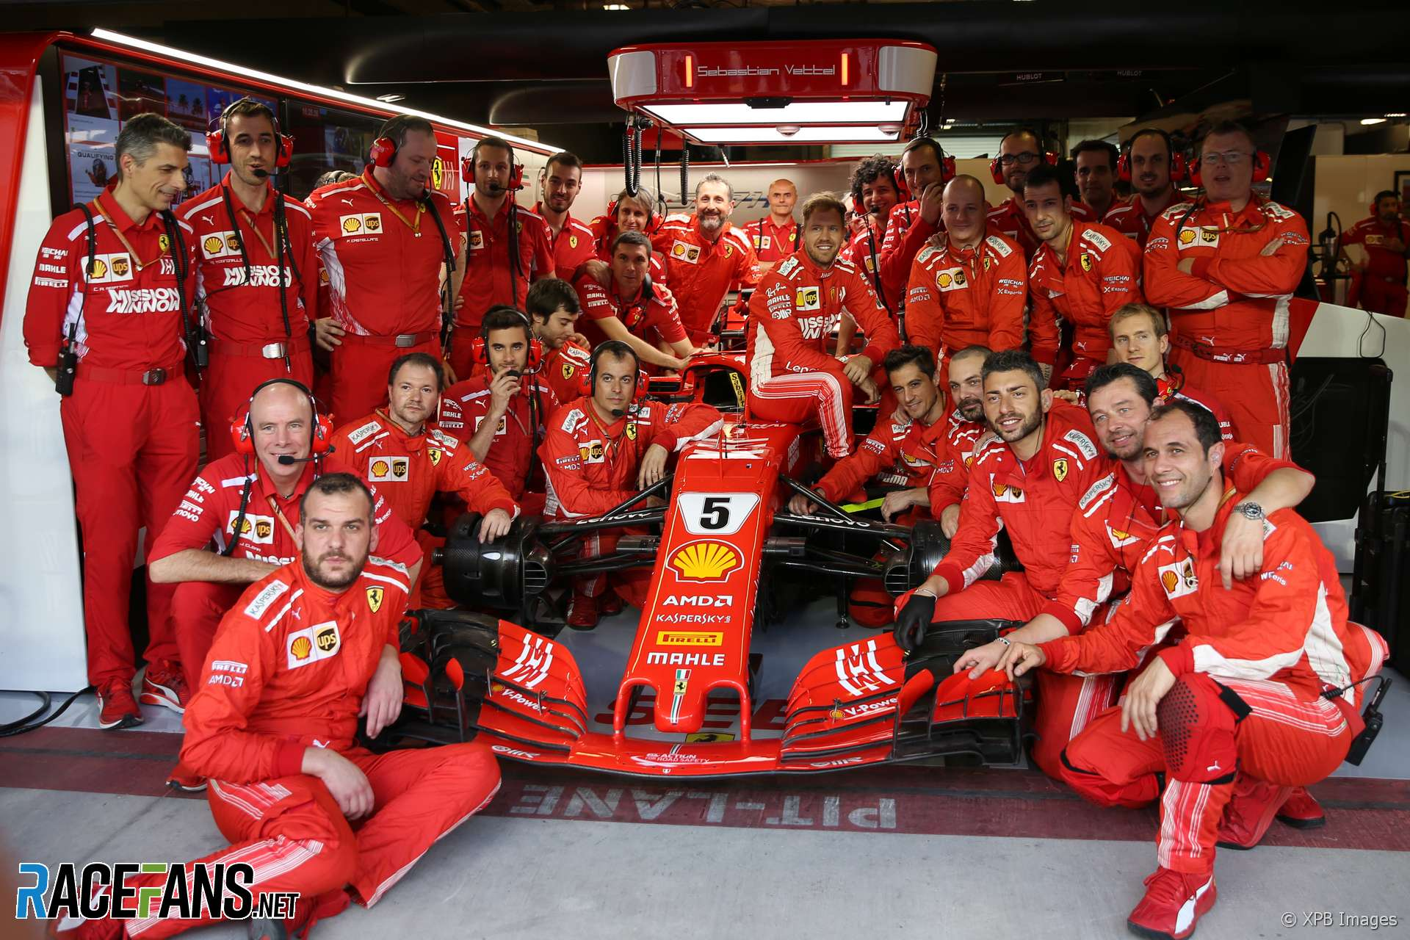
• As a team principal, it is my duty to keep improving the team so that we can compete with the other constructors and, hopefully, win the season.
• However, before I can improve something, I first need to understand WHAT it needs to be improved!

Slide 4
• So I’ve selected three areas where I feel the team is not meeting my expectations.
POTENTIAL ISSUES
1 – Our pit stops are subpar
2 – Vettel is underperforming
3 – The car is slower than Mercedes’
• The objective of this project is to change that “where I feel” to “where I know”. How?
• By using a graph database to query data obtained after an integration process.
• This portion will focus on the graph database!

Slide 5
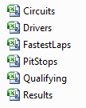

• My instruments for this portion will be:
Neo4j: a software that lets the user create a graph database and query the data inside it
A series of .csv files containing F1 stats obtained after integrating various sources with Talend

Slide 6
A brief overview on Neo4j
• Property-graph database • Written in Java
• Available in two versions: server and desktop • Desktop version uses JVM, server version can be accessed through REST operations • Useful for querying thanks to its Cypher language • Sharding not supported: the entire graph must be saved inside a machine • However it supports primary-secondaries architectures

Slide 7
POTENTIAL ISSUE 1
Are our pit stops subpar?

Slide 8
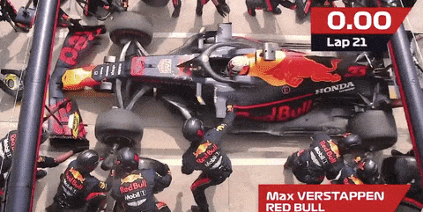
• Last year Red Bull registered the quickest pit stop in the entire history of Formula 1.
WHAT I WANT TO KNOW
Was it just luck or a symptom of a bigger problem: that we are just slower?

Slide 9
• The objective of this exercise will be to load in the graph database a .csv file containing all pit stops since 2011, and then querying the data in order to find our pit stops in the last season, calculate some stats, do the same for Red Bull, and then compare the results and see how we stack up.
• Let’s begin by loading the data in the graph database!

Slide 10
SOURCE FILE
- Pitstops(race, circuit, race_date, year, surname, name, stop, lap, duration, constructor)
LOADING INTO THE GRAPH
LOAD CSV WITH HEADERS FROM 'file:///Pitstops.csv' AS line FIELDTERMINATOR ';'
MERGE (x: Race {name: line.race, date: line.race_date, year: toInteger(line.year)})
MERGE (z: Circuit {name: line.circuit})
MERGE (y:Driver {surname: line.surname, name: line.name})
CREATE (y)-[:HAD_PITSTOP {stop: toInteger(line.stop), lap: toInteger(line.lap), duration_in_ms: toInteger(line.duration_in_ms), constructor: line.constructor}]->(x)
MERGE (x)-[:HELD_IN]->(z)
Must specify if a .csv file contains headers or how the data is divided.
Merge: if a particular node already exists, it doesn’t create a new one.

Slide 11
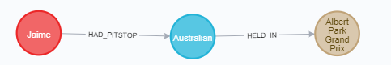
RESULT
:HELD_IN
:DRIVER {surname, name}
:RACE {name, date, year}
:HAD_PITSTOP {stop, lap, duration, constructor}
:CIRCUIT {name}
• LABELS • RELATIONSHIPS • PROPERTIES

Slide 12
QUERY 1
Average pit stop time per Ferrari and RedBull drivers last season
MATCH (d)-[dp:HAD_PITSTOP]->(r)
WHERE r.year = 2019 and (dp.constructor = "Ferrari" or dp.constructor = "Red Bull")
RETURN d.surname as surname, dp.constructor as constructor, avg(dp.duration_in_ms) as average_in_ms
QUERY 2
Average pit stop time per Ferrari and RedBull last season
MATCH (d)-[dp:HAD_PITSTOP]->(r)
WHERE r.year = 2019 and (dp.constructor = "Ferrari" or dp.constructor = "Red Bull")
RETURN dp.constructor as constructor, avg(dp.duration_in_ms) as average_in_ms

Slide 13
QUERY 3
Return quickest Ferrari and Red Bull pit stops for 2019
MATCH (d)-[dp:HAD_PITSTOP]->(r)
WHERE r.year = 2019 and (dp.constructor = "Ferrari" or dp.constructor = "Red Bull")
RETURN dp.constructor as constructor, min(dp.duration_in_ms) as quickest_in_ms
QUERY 4
Return slowest Ferrari and Red Bull pit stops for 2019
MATCH (d)-[dp:HAD_PITSTOP]->(r)
WHERE r.year = 2019 and (dp.constructor = "Ferrari" or dp.constructor = "Red Bull")
RETURN dp.constructor as constructor, max(dp.duration_in_ms) as slowest_in_ms

Slide 14
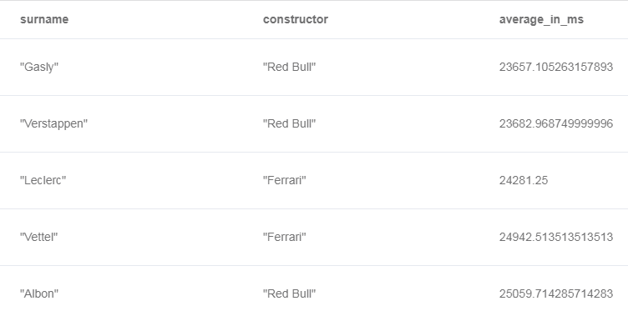
CONCLUSIONS
Looking at the results, and since Albon raced in too few races to make his average relevant, it’s fair to say that our pit stops are slower. We need either to improve or account for a ~1 second delay when making strategies that involve pitting.

Slide 15
POTENTIAL ISSUE 2
Is Vettel underperforming?

Slide 16
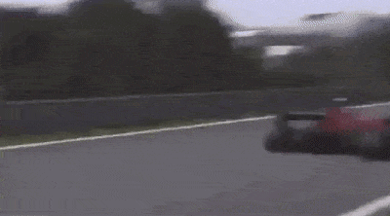
• Last year many claimed Vettel was feeling the pressure from his new teammate, Leclerc, which led him to some major mistakes.
WHAT I WANT TO KNOW
Is Vettel in a difficult situation, or are people just blinded by the hype for our younger driver?

Slide 17
• The objective of this exercise will be to load in the graph database a .csv file containing all the results since F1 started, and then querying the data in order to find out how many times Vettel has placed in a better place than his teammate per season, so that we can see if there is a downgrade in his performance across the years.
• Let’s begin by loading the data in the graph database!

Slide 18
SOURCE FILE
- Results(race_name, date, year, circuit, surname, name, constructor, grid, position, status)
LOADING INTO THE GRAPH
LOAD CSV WITH HEADERS FROM 'file:///Results.csv' AS line FIELDTERMINATOR ';'
MERGE (x:Race {name: line.race_name, date: line.date, year: toInteger(line.year)})
MERGE (z: Circuit {name: line.circuit})
MERGE (y:Driver {surname: line.surname, name: line.name})
CREATE (y)-[:FINISHED_AS {grid: toInteger(line.grid), position: line.position, status: line.status, constructor: line.constructor}]->(x)
MERGE (x)-[:HELD_IN]->(z)

Slide 19
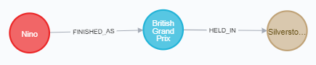
RESULT
:HELD_IN
:DRIVER {surname, name}
:RACE {name, date, year}
:FINISHED_AS {constructor, grid, position, status}
:CIRCUIT {name}
• LABELS • RELATIONSHIPS • PROPERTIES

Slide 20
QUERY 1
List of races where Vettel won against his teammate
MATCH (v)-[vr:FINISHED_AS]->(r)<-[tr:FINISHED_AS]-(t)
WHERE v.surname="Vettel" and ID(v) <> ID(t) and vr.constructor = tr.constructor and (toInteger(vr.position) < toInteger(tr.position) or tr.position = "\\N" and vr.position <> "\\N")
RETURN r.name as race, r.date as date, r.year as year, vr.position as vettel_position, t.surname as teammate, tr.position as teammate_position, vr.constructor as constructor
ORDER BY date

Slide 21
QUERY 2
Number of times Vettel has beaten his teammate per season
MATCH (v)-[vr:FINISHED_AS]->(r)<-[tr:FINISHED_AS]-(t)
WHERE v.surname="Vettel" and ID(v) <> ID(t) and vr.constructor = tr.constructor and (toInteger(vr.position) < toInteger(tr.position) or tr.position = "\\N" and vr.position <> "\\N")
RETURN r.year as year, t.surname as teammate, count(*) as vettel_wins
ORDER BY year

Slide 22
QUERY 3
List of races where Vettel lost against his teammate
MATCH (v)-[vr:FINISHED_AS]->(r)<-[tr:FINISHED_AS]-(t)
WHERE v.surname="Vettel" and ID(v) <> ID(t) and vr.constructor = tr.constructor and (toInteger(vr.position) > toInteger(tr.position) or tr.position <> "\\N" and vr.position = "\\N")
RETURN r.name as race, r.date as date, r.year as year, vr.position as vettel_position, t.surname as teammate, tr.position as teammate_position, vr.constructor as constructor
ORDER BY date

Slide 23
QUERY 4
Number of times Vettel has lost against his teammate per season
MATCH (v)-[vr:FINISHED_AS]->(r)<-[tr:FINISHED_AS]-(t)
WHERE v.surname="Vettel" and ID(v) <> ID(t) and vr.constructor = tr.constructor and (toInteger(vr.position) > toInteger(tr.position) or tr.position <> "\\N" and vr.position = "\\N")
RETURN r.year as year, t.surname as teammate, count(*) as vettel_lost
ORDER BY year

Slide 24
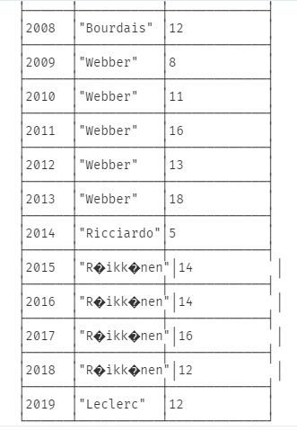
CONCLUSIONS
• Even though Vettel had a hard time against Leclerc, it was surprising to learn that it wasn’t any better last year or in 2014, where Ricciardo clearly gave a stronger performance!

Slide 25
POTENTIAL ISSUE 3
Are we slower than Mercedes?

Slide 26
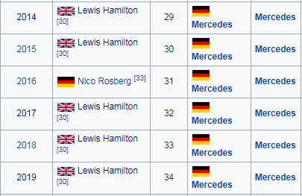
• It’s not a secret that Mercedes is dominating the recent era of Formula 1.
WHAT I WANT TO KNOW
Is this the result of unlucky circumstances or is our car just slower?

Slide 27
• The objective of this exercise will be to load in the graph database a .csv file containing all fastest laps per pilot and race since 2004, and then query the data in order to collect all fastest laps from races since 2014 in which each driver from both Ferrari and Mercedes had the opportunity to register a valid fast lap, and then sum the fast lap times per season and per pilot, and ultimately compare the results and see who has a quicker time.
• Let’s begin by loading the data in the graph database!

Slide 28
SOURCE FILE
- FastestLaps(race_name, date, year, circuit, surname, name, stop, constructor, fastestLap, fastestLapTime)
LOADING INTO THE GRAPH
LOAD CSV WITH HEADERS FROM 'file:///FastestLaps.csv' AS line FIELDTERMINATOR ';'
MERGE (x:Race {name: line.race_name, date: line.date, year: toInteger(line.year)})
MERGE (z: Circuit {name: line.circuit})
MERGE (y:Driver {surname: line.surname, name: line.name})
CREATE (y)-[:FASTEST_LAP {fastestLap: toInteger(line.fastestLap), fastestLapTime: line.fastestLapTime, constructor: line.constructor}]->(x)
MERGE (x)-[:HELD_IN]->(z)

Slide 29
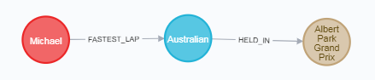
RESULT
:HELD_IN
:DRIVER {surname, name}
:RACE {name, date, year}
:FASTEST_LAP {constructor, fastestLap, fastestLapTime}
:CIRCUIT {name}
• LABELS • RELATIONSHIPS • PROPERTIES

Slide 30
QUERY 1
Return all races from >= 2014 where all Mercedes and Ferrari pilots registered a fast lap
MATCH (r: Race)<-[fl: FASTEST_LAP]-(d: Driver)
WHERE r.year >= 2014 and fl.fastestLap >= 10 and (fl.constructor = "Ferrari" or fl.constructor = "Mercedes")
WITH r, COUNT(*) as c
WHERE c = 4
RETURN r.name as name, r.date as date, r.year as year
ORDER BY year
WITH lets you carry the results of a query to the next one.

Slide 31
QUERY 2
Return all fastest laps from all >= 2014 races where all Mercedes and Ferrari pilots registered a fast lap
MATCH (r: Race)<-[fl: FASTEST_LAP]-()
WHERE r.year >= 2014 and fl.fastestLap >= 10 and (fl.constructor = "Ferrari" or fl.constructor = "Mercedes")
WITH r, COUNT(*) as c
WHERE c = 4
MATCH (r)<-[fl: FASTEST_LAP]-(d: Driver)
WHERE fl.constructor = "Ferrari" or fl.constructor = "Mercedes"
RETURN r.name as name, r.date as date, r.year as year, d.surname as surname, fl.fastestLapTime as fastestLapTime
ORDER BY year

Slide 32
QUERY 3
Return the sum in ms of all fastest laps from all >= 2014 races where all Mercedes and Ferrari pilots registered a fast lap
MATCH (r: Race)<-[fl: FASTEST_LAP]-()
WHERE r.year >= 2014 and fl.fastestLap >= 10 and (fl.constructor = "Ferrari" or fl.constructor = "Mercedes")
WITH r, COUNT(*) as c
WHERE c = 4
MATCH (r)<-[fl: FASTEST_LAP]-(d: Driver)
WHERE fl.constructor = "Ferrari" or fl.constructor = "Mercedes"
WITH r, d, [item in split(fl.fastestLapTime, ":") | toInteger(item)] AS timeComponents1, [item in split(fl.fastestLapTime, ".") | toInteger(item)] AS timeComponents2
RETURN r.year as year, d.surname as surname, sum(timeComponents1[0]*60000+timeComponents1[1]*1000+timeComponents2[1]) AS total_time
ORDER BY year
We can’t sum dates, so we need to split and convert the format ‘mm.ss.SSS’ to ms

Slide 33
QUERY 4
Return the sum in mm:ss.SSS of all fastest laps from all >= 2014 races where all Mercedes and Ferrari pilots registered a fast lap
MATCH (r: Race)<-[fl: FASTEST_LAP]-()
WHERE r.year >= 2014 and fl.fastestLap >= 10 and (fl.constructor = "Ferrari" or fl.constructor = "Mercedes")
WITH r, COUNT(*) as c
WHERE c = 4
MATCH (r)<-[fl: FASTEST_LAP]-(d: Driver)
WHERE fl.constructor = "Ferrari" or fl.constructor = "Mercedes"
WITH r, d, [item in split(fl.fastestLapTime, ":") | toInteger(item)] AS timeComponents1, [item in split(fl.fastestLapTime, ".") | toInteger(item)] AS timeComponents2
RETURN r.year as year, d.surname as surname, apoc.date.format(sum(timeComponents1[0]*60000+timeComponents1[1]*1000+timeComponents2[1]), "ms", "mm:ss.SSS") AS total_time
ORDER BY year
NOTE: in order to use apoc we need to install the plugin!

Slide 34
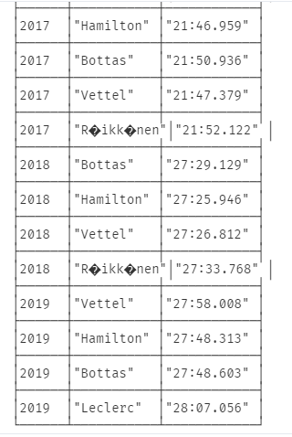
CONCLUSIONS
• This data shows that we clearly need to keep improving the performance of our car because Mercedes is still ahead!

Slide 35
FINAL REMARKS
• By integrating and querying data, I could take a authentic look at how various aspects of the team have performed and where - and if - they fell short. • The answers I gained from this analysis will help me make decisions in the future that will be based on facts and not subjective feelings, which was exactly my initial objective!

Slide 36
BONUS
Let’s add and query more data!

Slide 37
UPDATING THE GRAPH 1
Add more informations to the circuits
LOAD CSV WITH HEADERS FROM 'file:///Circuits.csv' AS line FIELDTERMINATOR ';'
MERGE (c: Circuit {name: line.name})
SET c.location = line.location
SET c.country = line.country
SET c.lat = line.lat
SET c.lon = line.lon

Slide 38
UPDATING THE GRAPH 2
Add more informations to the drivers
LOAD CSV WITH HEADERS FROM 'file:///Drivers.csv' AS line FIELDTERMINATOR ';'
MERGE (d: Driver {surname: line.surname, name: line.forename})
SET d.number = line.number
SET d.code = line.code
SET d.dob = line.dob
SET d.nationality = line.nationality

Slide 39
UPDATING THE GRAPH 3
Add information about qualifying
LOAD CSV WITH HEADERS FROM 'file:///Qualifying.csv' AS line FIELDTERMINATOR ';'
MATCH (d: Driver {surname: line.surname, name: line.name}) MATCH (r: Race {name: line.race, date: line.race_date, year: toInteger(line.year)})
MERGE (d)-[:QUALIFIED_AS {position: line.position, q1: line.q1, q2: line.q2, q3: line.q3, constructor: line.constructor}]->(r)

Slide 40
QUERY 1
All wins by Ferrari drivers since the beginning of F1
MATCH (d)-[vr:FINISHED_AS]->(r)
WHERE vr.constructor = "Ferrari" and vr.position = "1"
RETURN r.date as date, d.surname as surname, d.name as name, r.name as circuit
ORDER BY date
QUERY 2
All wins by Michael Schumacher when he was in Ferrari
MATCH (d)-[vr:FINISHED_AS]->(r)
WHERE vr.constructor = "Ferrari" and vr.position = "1" and d.name = "Michael" and d.surname = "Schumacher"
RETURN r.date as date, r.name as circuit
ORDER BY date

Slide 41
QUERY 3
All DNF from Ferrari
MATCH (d)-[vr:FINISHED_AS]->(r)
WHERE vr.constructor = "Ferrari" and vr.position = "\\N"
RETURN r.date as date, r.name as circuit, d.surname as surname, d.name as name, vr.status as status
ORDER BY date
QUERY 4
All Italian pilots who drove for Ferrari
MATCH (d: Driver)-[r]->()
WHERE r.constructor = "Ferrari" and d.nationality = "Italian"
RETURN DISTINCT d.surname as surname, d.name as name

Slide 42
QUERY 5
All races by Michael Schumacher where he both took pole position and won, when he was in Ferrari
MATCH (d)-[vr:FINISHED_AS]->(r)<-[qa:QUALIFIED_AS]-(d)
WHERE vr.constructor = "Ferrari" and vr.position = "1" and d.name = "Michael" and d.surname = "Schumacher" and qa.position = "1"
RETURN r.date as date, r.name as circuit
ORDER BY date

Slide 43
QUERY 6
Fastest qualifying lap at Monza by a Ferrari driver
MATCH (d)-[qa:QUALIFIED_AS]->(r)-[:HELD_IN]->(c)
WHERE qa.constructor = "Ferrari" and c.name = "Autodromo Nazionale di Monza"
WITH min(qa.q3) as fastest_qualify
MATCH (d)-[qa:QUALIFIED_AS]->(r)
WHERE qa.q3 = fastest_qualify
RETURN d.surname as surname, fastest_qualify, r.date as date

Slide 44
INDEX CREATION
CREATE INDEX FOR (d: Driver) ON (d.surname)
• Time to answer the “All Ferrari wins by Michael Schumacher” query before the index:
• Same query, but after the index:

Slide 45
REFERENCES
• Kaggle F1 Dataset: https://www.kaggle.com/rohanrao/formula-1-world-championship-1950-2020
• Talend Website: https://www.talend.com/
• Neo4j Website: https://neo4j.com/

